Slide 1

Chapter 4: Project Integration Management
Information Technology Project Management, Seventh Edition
Note: See the text itself for full citations.

Slide 2
The Key to Overall Project Success: Good Project Integration Management
Project managers must coordinate all of the other knowledge areas throughout a project’s life cycle
Many new project managers have trouble looking at the “big picture” and want to focus on too many details
Project integration management is not the same thing as software integration

Slide 3
Project Integration Management Processes
1. Developing the project charter involves working with stakeholders to create the document that formally authorizes a project—the charter.
2. Developing the project management plan involves coordinating all planning efforts to create a consistent, coherent document—the project management plan.
3. Directing and managing project work involves carrying out the project management plan by performing the activities included in it.

Slide 4
Project Integration Management Processes (cont’d)
Monitoring and controlling project work involves overseeing activities to meet the performance objectives of the project
Performing integrated change control involves identifying, evaluating, and managing changes throughout the project life cycle.
Closing the project or phase involves finalizing all activities to formally close the project or phase.

Slide 5
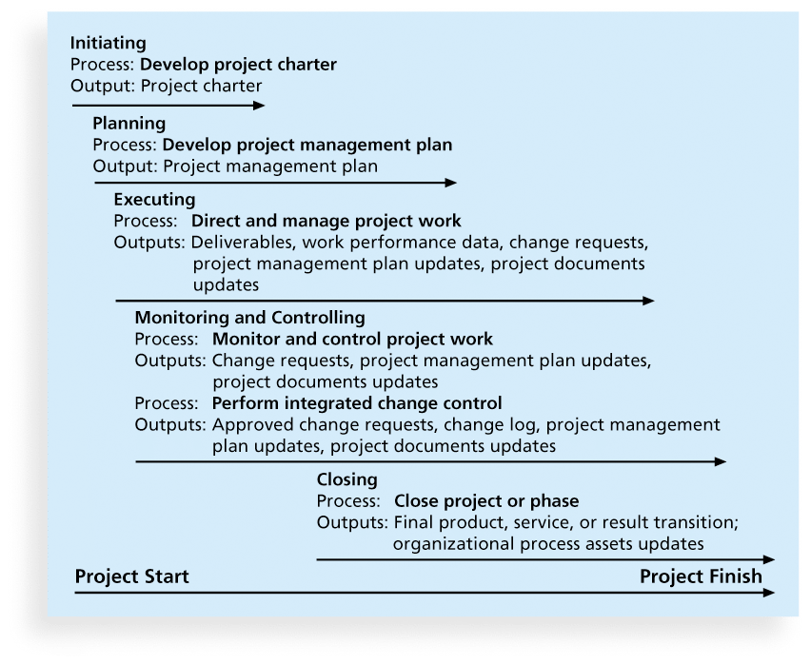
Figure 4-1. Project Integration Management Summary

Slide 6
Strategic Planning and Project Selection
Strategic planning involves determining long-term objectives, predicting future trends, and projecting the need for new products and services
Organizations often perform a SWOT analysis
analyzing Strengths, Weaknesses, Opportunities, and Threats
As part of strategic planning, organizations
identify potential projects
use realistic methods to select which projects to work on
formalize project initiation by issuing a project charter

Slide 7
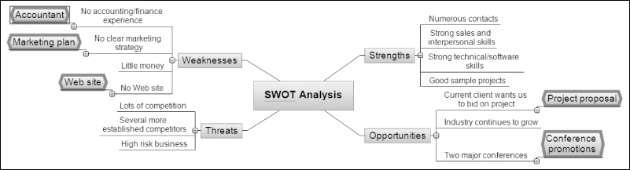
Figure 4-2. Mind Map of a SWOT Analysis to Help Identify Potential Projects

Slide 8
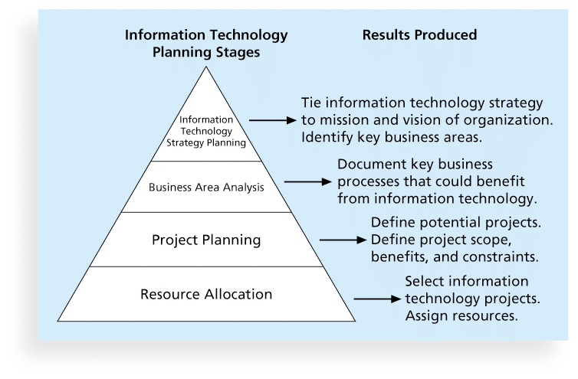
Figure 4-3. Information Technology Planning Process

Slide 9
Project Management
Project Selection
(Which project should be supported?)

Slide 10
Why is Project Selection Important?
The FIRST STEP in successful projects
Wasted resources with starts and stops, high-risk, high-cost projects
Lost opportunity costs of not doing the “right” projects
Completion of projects that do not contribute to the organization’s strategic direction (throw-aways)

Slide 11
Screening & Selection Issues
Risk – unpredictability to the firm
Commercial – market potential
Internal operating – changes in firm operations
Additional – image, patent, fit, etc.
All models only partially reflect reality and have both objective and subjective factors imbedded

Slide 13
Methods for Selecting Projects
There are usually more projects than available time and resources to implement them
Methods for selecting projects include:
focusing on broad organizational needs
categorizing information technology projects
performing net present value or other financial analyses
using a weighted scoring model
implementing a balanced scorecard

Slide 14
Focusing on Broad Organizational Needs
It is often difficult to provide strong justification for many IT projects, but everyone agrees they have a high value
“It is better to measure gold roughly than to count pennies precisely”
Three important criteria for projects:
There is a need for the project
There are funds available
There’s a strong will to make the project succeed

Slide 15
Categorizing IT Projects
One categorization is whether the project addresses
a problem
an opportunity, or
a directive
Another categorization is how long it will take to do and when it is needed
Another is the overall priority of the project

Slide 16
Financial Analysis of Projects
Financial considerations are often an important consideration in selecting projects
Three primary methods for determining the projected financial value of projects:
Net present value (NPV) analysis
Return on investment (ROI)
Payback analysis

Slide 17
Checklist Model
A checklist is a list of criteria applied to possible projects.
Requires agreement on criteria
Assumes all criteria are equally important
Checklists are valuable for recording opinions and encouraging discussion

Slide 18
Simplified Checklist Model for Project Selection Performance on criteria

Slide 19
Simplified Scoring Models
Each project receives a score that is the weighted sum of its grade on a list of criteria. Scoring models require:
agreement on criteria
agreement on weights for criteria
a score assigned for each criteria
Relative scores can be misleading!

Slide 20
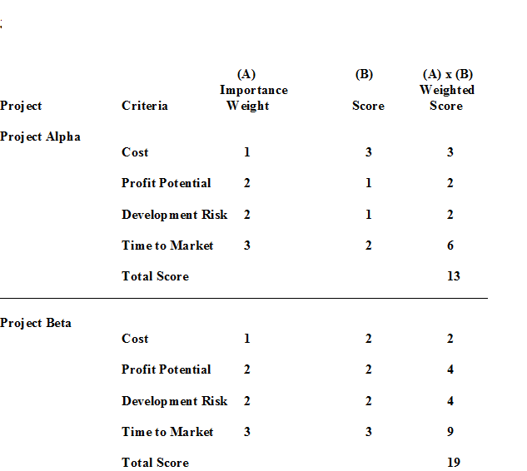
Simple Scoring

Slide 21
Weighted Scoring Model
A weighted scoring model is a tool that provides a systematic process for selecting projects based on many criteria
Identify criteria important to the project selection process
Assign weights (percentages) to each criterion so they add up to 100%
Assign scores to each criterion for each project
Multiply the scores by the weights and get the total weighted scores
The higher the weighted score, the better

Slide 22
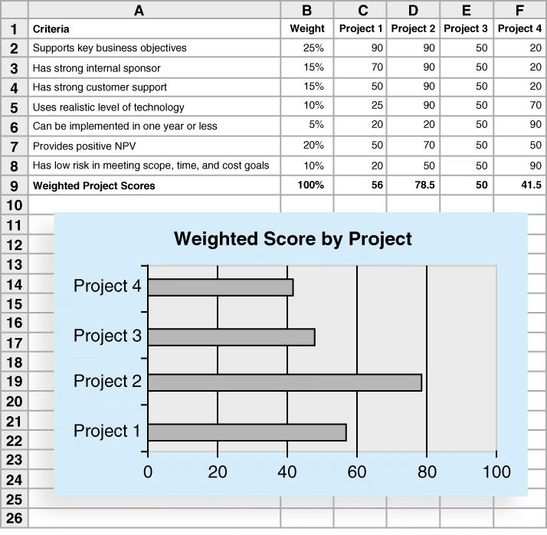
Figure 4-7. Sample Weighted Scoring Model for Project Selection

Slide 23
Benefits of Scoring Models
Structurally simple
Multiple decision criteria
Easy to modify
Easy to do “what if” or sensitivity analysis
Weights provide flexibility

Slide 24
Drawbacks of Scoring Models
It is a “ranking” method, but does NOT necessarily represent “true” value
Quantitative value may cause decisions without “judgment”
Assigning values sometimes is haphazard
Input value changes (assumptions) may cause large swings in results

Slide 25
Financial Models: Profit / Profitability
Based on the time value of money principal
Payback Period (PB)
Average Rate of Return
Net present value (NPV)
Internal Rate of Return
Profitability Index

Slide 26
Payback Period
Refers to the period of time required for the return on an investment to "repay" the sum of the original investment
Cash flows should be discounted
Lower numbers are better (faster payback)

Slide 27
Payback Period Example
A project requires an initial investment of $200,000 and will generate cash savings of $75,000 each year for the next five years. What is the payback period?
Year | Cash Flow | Cumulative
0 | -$200,000 | -$200,000
1 | $75,000 | -$125,000
2 | $75,000 | -$50,000
3 | $75,000 | $25,000
Divide the cumulative amount by the cash flow amount in the third year and subtract from 3 to find out the moment the project breaks even.

Slide 28
Payback Analysis
Another important financial consideration is payback analysis
The payback period is the amount of time it will take to recoup, in the form of net cash inflows, the total dollars invested in a project
Payback occurs when the net cumulative discounted benefits equals the costs
Many organizations want IT projects to have a fairly short payback period

Slide 29
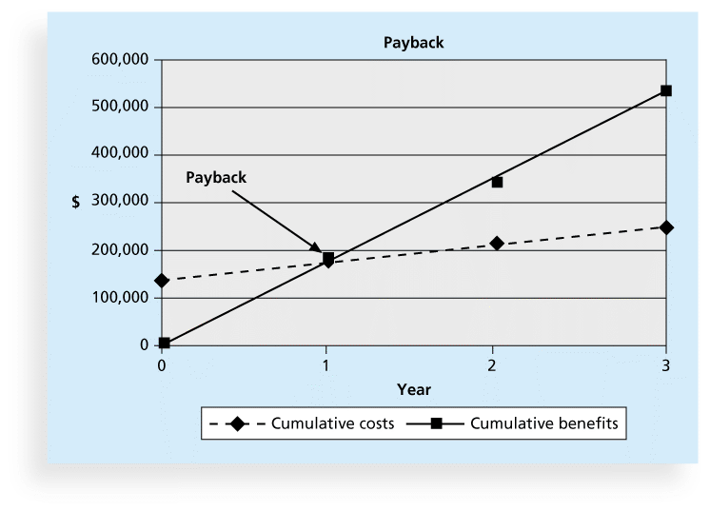
Figure 4-6. Charting the Payback Period

Slide 30
Net Present Value
Projects the change in the firm’s stock value if a project is undertaken.
Higher NPV values are better!

Slide 31
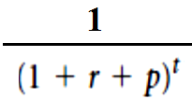
Net Present Value Example
Should you invest $60,000 in a project that will return $15,000 per year for five years? You have a minimum return of 8% and expect inflation to hold steady at 3% over the next five years.
Year | Net flow | Discount | NPV
0 | -$60,000 | 1.0000 | -$60,000.00
1 | $15,000 | 0.9009 | $13,513.51
2 | $15,000 | 0.8116 | $12,174.34
3 | $15,000 | 0.7312 | $10,967.87
4 | $15,000 | 0.6587 | $9,880.96
5 | $15,000 | 0.5935 | $8,901.77
 |  |  | -$4,561.54
The NPV column total is negative, so don’t invest!

Slide 32
NPV - Example
 | Now | Year 1 | Year 2 | Year 3
Startup cost | 50,000
Running cost |  | 30,000 | 45,000 | 45,000
revenues |  | 40,000 | 50,000 | 60,000
Sales of business |  |  |  | 70,000

Slide 33
NPV - Example
NPV= start-up cost+Npv(year1)+ Npv(year2)+ Npv(year3)
= -50000 + ((-30000+40000)/(1+0.12)**1) +
((-45000+50000)/(1+0.12)**2) +
((-45000+60000+70000)/(1+0.12)**3
= -50000 +9828+3986+60501
= 23415
So , the project on this basis is worth pursuing.

Slide 34
Net Present Value Analysis
Net present value (NPV) analysis is a method of calculating the expected net monetary gain or loss from a project by discounting all expected future cash inflows and outflows to the present point in time
Projects with a positive NPV should be considered if financial value is a key criterion
The higher the NPV, the better

Slide 35
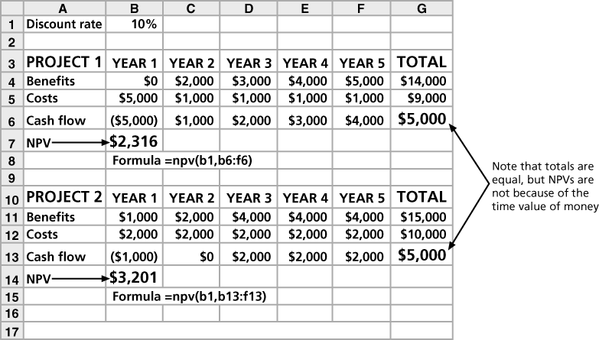
Figure 4-4. Net Present Value Example

Slide 36
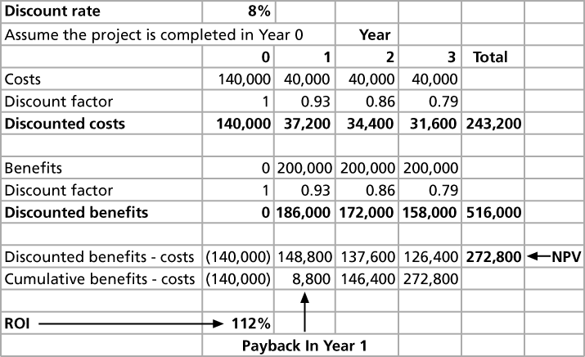
Figure 4-5. JWD Consulting NPV Example
Note: See the template called business_case_financials.xls

Slide 37
NPV Calculations
Determine estimated costs and benefits for the life of the project and the products it produces
Determine the discount rate (check with your organization on what to use)
Calculate the NPV (see text for details)
Notes: Some organizations consider the investment year as year 0, while others start in year 1. Some people entered costs as negative numbers, while others do not. Check with your organization for their preferences

Slide 38
Return on Investment
Return on investment (ROI) is calculated by subtracting the project costs from the benefits and then dividing by the costs
ROI = (total discounted benefits - total discounted costs) / discounted costs
The higher the ROI, the better
Many organizations have a required rate of return or minimum acceptable rate of return on investment for projects
Internal rate of return (IRR) can by calculated by finding the discount rate that makes the NPV equal to zero

Slide 39
Implementing a Balanced Scorecard
Drs. Robert Kaplan and David Norton developed this approach to help select and manage projects that align with business strategy
A balanced scorecard
is a methodology that converts an organization’s value drivers, such as customer service, innovation, operational efficiency, and financial performance, to a series of defined metrics
See www.balancedscorecard.org for more information

Slide 40
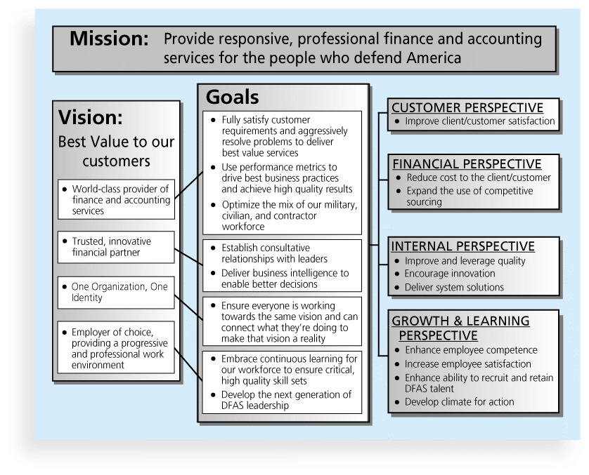
Figure 4-8. Balanced Scorecard Example

Slide 41
Developing a Project Charter
After deciding what project to work on, it is important to let the rest of the organization know
A project charter is a document that formally recognizes the existence of a project and provides direction on the project’s objectives and management
Key project stakeholders should sign a project charter to acknowledge agreement on the need and intent of the project; a signed charter is a key output of project integration management

Slide 42
Inputs for Developing a Project Charter
A project statement of work
A business case
Agreements
Enterprise environmental factors
Organizational process assets, which include formal and informal plans, policies, procedures, guidelines, information systems, financial systems, management systems, lessons learned, and historical information

Slide 43
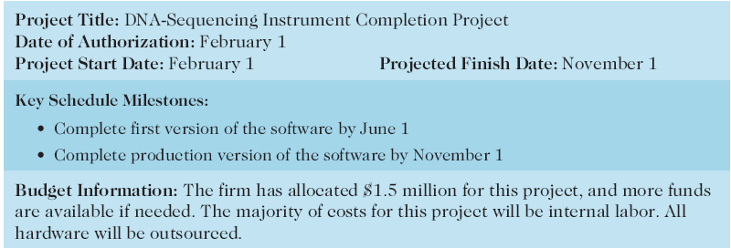
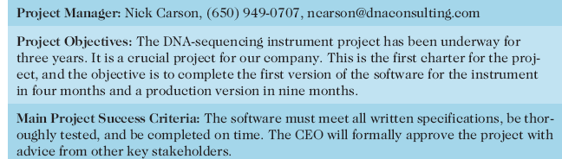
Table 4-1. Project Charter for the DNA-Sequencing Instrument Completion Project

Slide 44
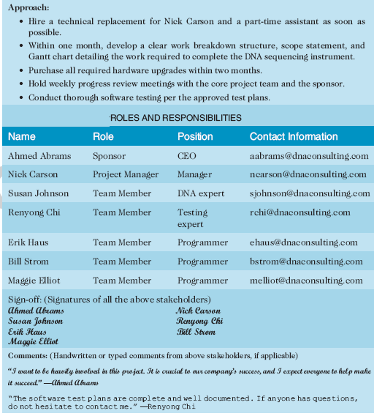
Table 4-1. Project Charter (cont.)

Slide 45
Developing a Project Management Plan
A project management plan is a document used to coordinate all project planning documents and help guide a project’s execution and control
Plans created in the other knowledge areas are subsidiary parts of the overall project management plan

Slide 46
Common Elements of a Project Management Plan
Introduction or overview of the project
Description of how the project is organized
Management and technical processes used on the project
Work to be done, schedule, and budget information

Slide 47
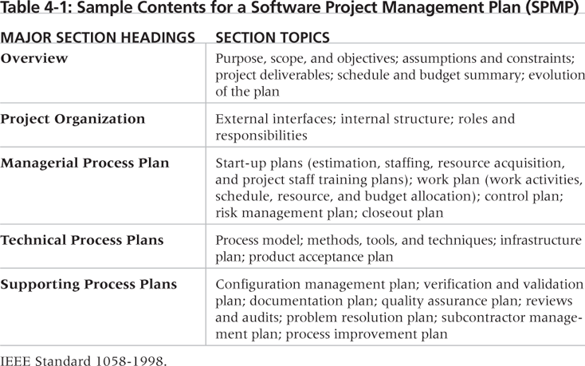
Table 4-2. Sample Contents for a Software Project Management Plan (SPMP)

Slide 48
What the Winners Do
"The winners clearly spell out what needs to be done in a project, by whom, when, and how. For this they use an integrated toolbox, including PM tools, methods, and techniques…If a scheduling template is developed and used over and over, it becomes a repeatable action that leads to higher productivity and lower uncertainty. Sure, using scheduling templates is neither a breakthrough nor a feat. But laggards exhibited almost no use of the templates. Rather, in constructing schedules their project managers started with a clean sheet, a clear waste of time.“*
*Milosevic, Dragan and And Ozbay. “Delivering Projects: What the Winners Do.” Proceedings of the Project Management Institute Annual Seminars & Symposium (November 2001).

Slide 49
Directing and Managing Project Work
Involves managing and performing the work described in the project management plan
The majority of time and money is usually spent on execution
The application area of the project directly affects project execution because the products of the project are produced during execution

Slide 50
Coordinating Planning and Execution
Project planning and execution are intertwined and inseparable activities
Those who will do the work should help to plan the work
Project managers must solicit input from the team to develop realistic plans

Slide 51
Providing Leadership and a Supportive Culture
Project managers must lead by example to demonstrate the importance of creating and then following good project plans
Organizational culture can help project execution by
providing guidelines and templates
tracking performance based on plans
Project managers may still need to break the rules to meet project goals, and senior managers must support those actions

Slide 52
Capitalizing on Product, Business, and Application Area Knowledge
It is often helpful for IT project managers to have prior technical experience
On small projects, the project manager may be required to perform some of the technical work or mentor team members to complete the projects
On large projects, the project manager must understand the business and application area of the project

Slide 53
Project Execution Tools and Techniques
Expert judgment: Experts can help project managers and their teams make many decisions related to project execution
Meetings: Meetings allow people to develop relationships, pick up on important body language or tone of voice, and have a dialogue to help resolve problems.
Project management information systems: There are hundreds of project management software products available on the market today, and many organizations are moving toward powerful enterprise project management systems that are accessible via the Internet
See the What Went Right? example of Kuala Lumpur’s Integrated Transport Information System on p. 169

Slide 54
Monitoring and Controlling Project Work
Changes are inevitable on most projects, so it’s important to develop and follow a process to monitor and control changes
Monitoring project work includes collecting, measuring, and disseminating performance information
A baseline is the approved project management plan plus approved changes

Slide 55
Media Snapshot
The 2002 Olympic Winter Games and Paralympics took five years to plan and cost more than $1.9 billion. PMI awarded the Salt Lake Organizing Committee (SLOC) the Project of the Year award for delivering world-class games.
Four years before the Games began, the SLOC used a Primavera software-based system with a cascading color-coded WBS to integrate planning…The SLOC also used an Executive Roadmap, a one-page list of the top 100 Games-wide activities, to keep executives apprised of progress. Activities were tied to detailed project information within each department’s schedule. A 90-day highlighter showed which managers were accountable for each integrated activity.
Fraser Bullock, SLOC Chief Operating Officer and Chief, said, “We knew when we were on and off schedule and where we had to apply additional resources. The interrelation of the functions meant they could not run in isolation—it was a smoothly running machine.”*
*Foti, Ross, “The Best Winter Olympics, Period,” PM Network (January 2004) 23.

Slide 56
Performing Integrated Change Control
Three main objectives are:
Influencing the factors that create changes to ensure that changes are beneficial
Determining that a change has occurred
Managing actual changes as they occur

Slide 57
Change Control on Information Technology Projects
Former view: The project team should strive to do exactly what was planned on time and within budget
Problem: Stakeholders rarely agreed up-front on the project scope, and time and cost estimates were inaccurate
Modern view: Project management is a process of constant communication and negotiation
Solution: Changes are often beneficial, and the project team should plan for them

Slide 58
Change Control System
A change control system is a formal, documented process that describes when and how official project documents and work may be changed
Describes who is authorized to make changes and how to make them

Slide 59
Change Control Board (CCB)
A change control board is a formal group of people responsible for approving or rejecting changes on a project
CCBs provide guidelines for preparing change requests, evaluate change requests, and manage the implementation of approved changes
Includes stakeholders from the entire organization

Slide 60
Making Timely Changes
Some CCBs only meet occasionally, so it may take too long for changes to occur
Some organizations have policies in place for time-sensitive changes
“48-hour policy” allows project team members to make decisions, then they have 48 hours to reverse the decision pending senior management approval
Delegate changes to the lowest level possible, but keep everyone informed of changes

Slide 61
Global Issues
Rapid changes in technology, such as the increased use of mobile roaming for communications, often cause governments around the world to take action.
Incompatible hardware, software, and networks can make communications difficult in some regions, and a lack of competition can cause prices to soar.
Fortunately, a group called the Organisation for Economic Co-operation and Development (OECD) promotes policies that will improve the economic and social well-being of people around the world.
In February 2012, the OECD called upon its members’ governments to boost competition in international mobile roaming markets.

Slide 62
Configuration Management
Configuration management ensures that the descriptions of the project’s products are correct and complete
Involves identifying and controlling the functional and physical design characteristics of products and their support documentation
Configuration management specialists identify and document configuration requirements, control changes, record and report changes, and audit the products to verify conformance to requirements
See www.icmhq.com for more information

Slide 63
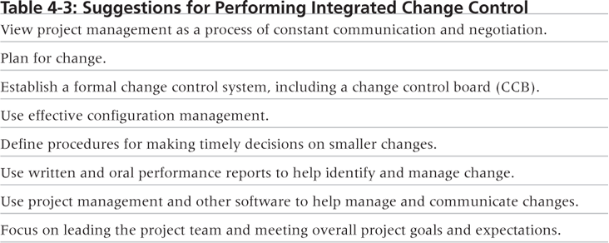
Table 4-3. Suggestions for Performing Integrated Change Control

Slide 64
Closing Projects or Phases
To close a project or phase, you must finalize all activities and transfer the completed or cancelled work to the appropriate people
Main outputs include
Final product, service, or result transition
Organizational process asset updates

Slide 65
Using Software to Assist in Project Integration Management
Several types of software can be used to assist in project integration management
Documents can be created with word processing software
Presentations are created with presentation software
Tracking can be done with spreadsheets or databases
Communication software like e-mail and Web authoring tools facilitate communications
Project management software can pull everything together and show detailed and summarized information
Business Service Management (BSM) tools track the execution of business process flows

Slide 66
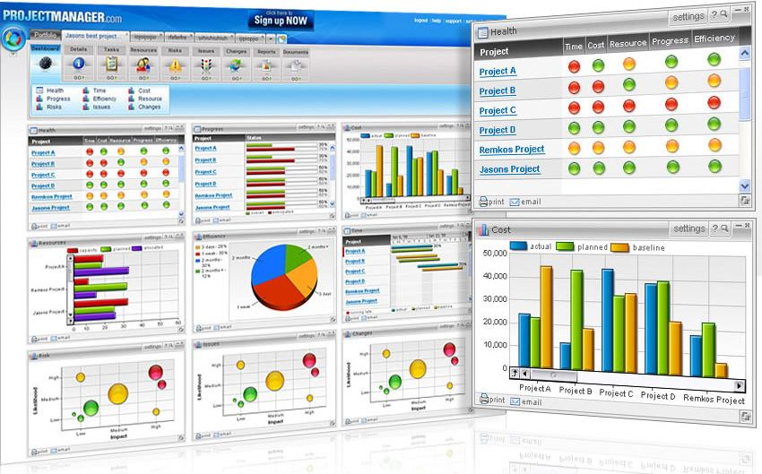
Figure 4-9. Sample Portfolio Management Software Screen
Source: www.projectmanager.com

Slide 67
Chapter Summary
Project integration management involves coordinating all of the other knowledge areas throughout a project’s life cycle
Main processes include
Develop the project charter
Develop the project management plan
Direct and manage project execution
Monitor and control project work
Perform integrated change control
Close the project or phase

